Slide 1
R and Rstudio
Ramsy Agha
Feb 2020
Disease Eco-Evo Lab

Slide 2
Timetable
Day / (who?) | Time | Topic
Thu 6.2.20 (Ramsy) | 10.00-11.00 | Intro to R and Rstudio (Lecture w/ exercises)
 | 11.00-12.30 | Data import and quality check (Exercise)
 | 12.30 -13.30 | Data manipulation – Apply functions (Mini-Lecture and Exercise)
 | 13.30 | Lunch break
 | 14.00-15.00 | Break for IGB Kolloquium
 | 15.00 – 17.00 | Visualization with ggplot2 (Guided tutorial)
 | 17.00 – 17.30 | Q&As
Fri 14.2.20 (Florent) | morning | Statistical analyses using R
 | afternoon | Group Challenge and Open lab (work with your data)

Slide 3
Good Practice during this tutorial
Mind the Cats!
Try challenges out
Ask lots of questions
Help your neighbor
Take breaks if needed
Cheat!
But: NO COPY PASTE ALLOWED

Slide 4
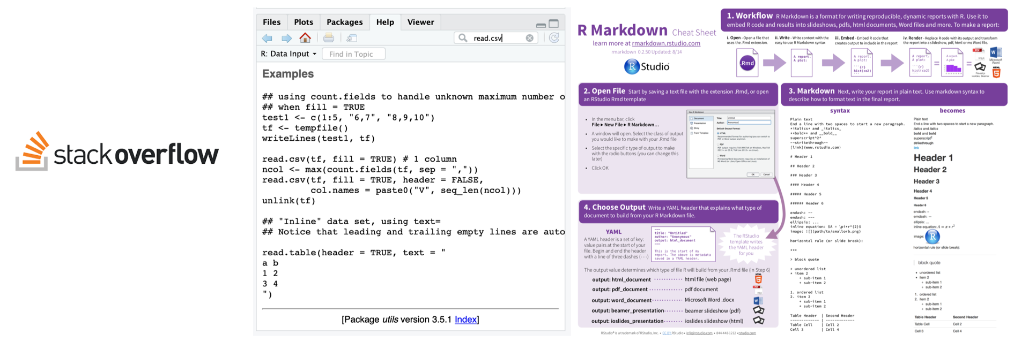
Cheating is allowed
Stackoverflow
?function() (takes you to documentation pages)
cheatsheets (see folder in the course repository)

Slide 5
Are You Typing too much? You’re Doing Something Wrong!
Tab complete
is a nice trick to save you typing, functions, dataset names, variables etc. that have been defined in the R environment will be autocompleted.
Get used to it and use it always, it will make you faster and you will avoid typos!

Slide 6


Mind the cats!
Watching vs. Doing
Listen when you see this cat
Do when you see this cat

Slide 7
All course materials are available
https://github.com/ramsyagha/tutorials

Slide 8

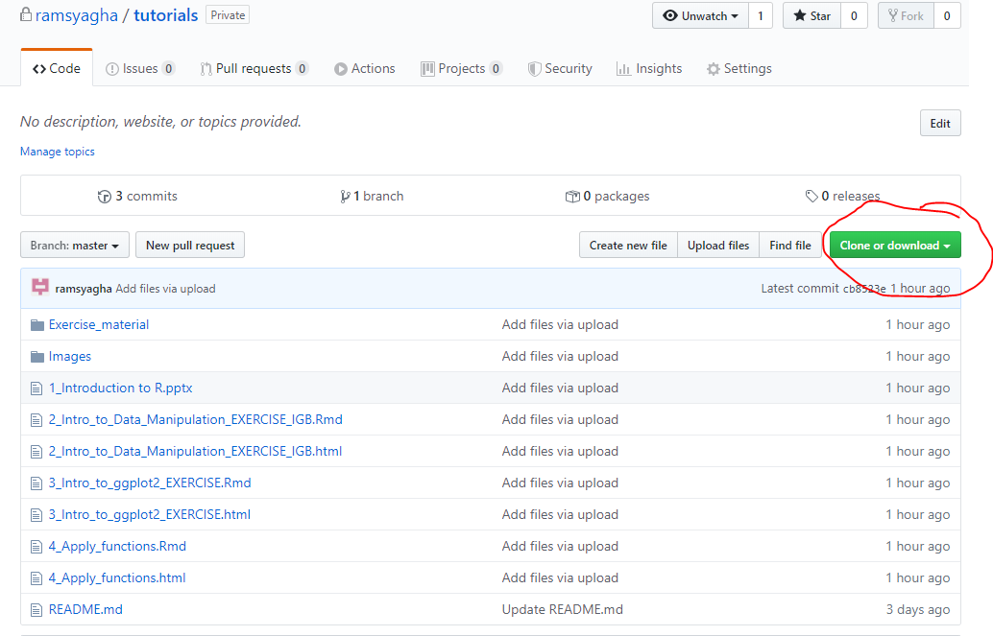
All course materials are available
https://github.com/ramsyagha/tutorials
Remember the PATH where you extract the zip file:
This will be your working directory in RStudio!
If haven´t already,
Pls do this now!

Slide 9
Tutorial 1: Introduction to R
Ramsy Agha
Feb 2020
Disease Eco-Evo Lab

Slide 10
R and RStudio
R: free software environment for statistical computing and graphics
RStudio: integrated development environment (IDE) for R

Slide 11
Why R?
powerful, flexible/customizable
easy for sharing and developing
reproducible science: scripts and markdowns

Slide 12
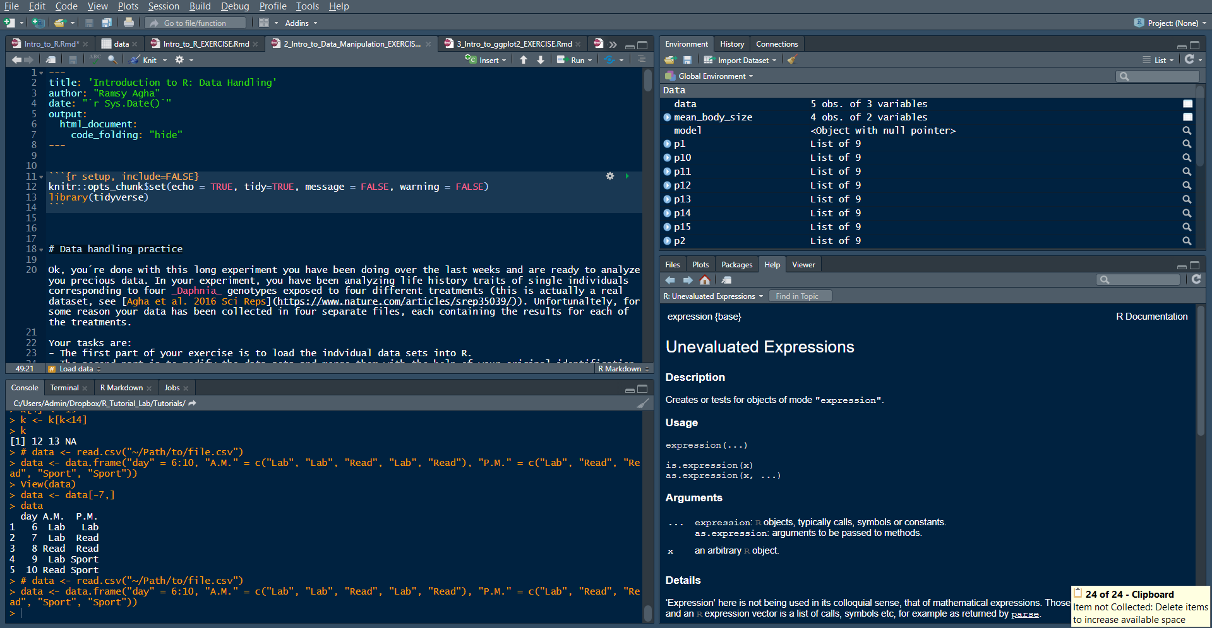
What is RStudio
SOURCE (Your notepad for code)
This is where you write your code
Your code will not be evaluated until you run it
(use „run“ button or Ctrl+Enter to run individual lines of code)
3. ENVIRONMENT / HISTORY
Here you can see what objects are loaded into your working space and see your command history
4. FILES/PLOTS/PACKAGES/HELP
Here you can see file, directories, packages and help documentation (R help).
2. CONSOLE (R´s heart)
This is where your code from the source will be evaluated by R
You can also perform quick calculations that you dont need to save

Slide 13
Try it now

Slide 14
Error messages
Warnings should be acknowledged but can be ignored.
Specific hint? e.g.
wrong data format, characters/factors instead of numbers
library not loaded, package not installed
Google is your friend – cheating is allowed

Slide 15
Operators in R
Arithmetic operators
Type in your console (and press enter):
12+13+14
(5+2)*2
12^2
These are Arithmetic operators (basic math): +, -, *, /, ^, …

Slide 16
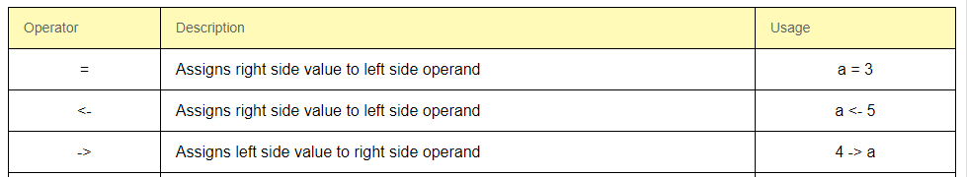
Operators in R
Assigment operators
These are assigment operators: assign a value to the variable

Slide 17
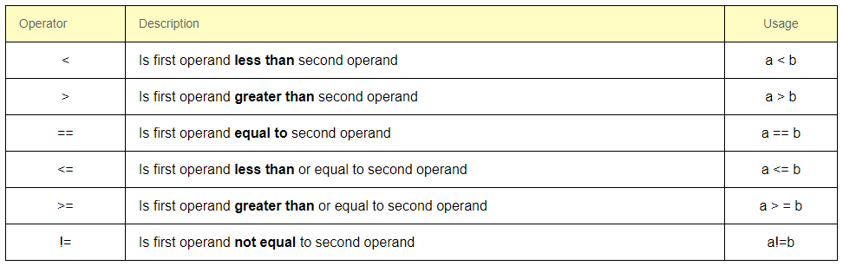
Operators in R
Relational operators
These are relational operators: relation between the two operands

Slide 18
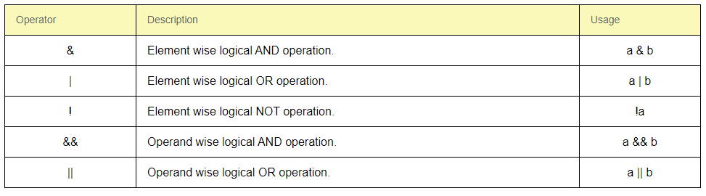
Operators in R
Logical Operators

Slide 19
Objects and functions
R is all about 2 things:
Objects and Functions

Slide 20
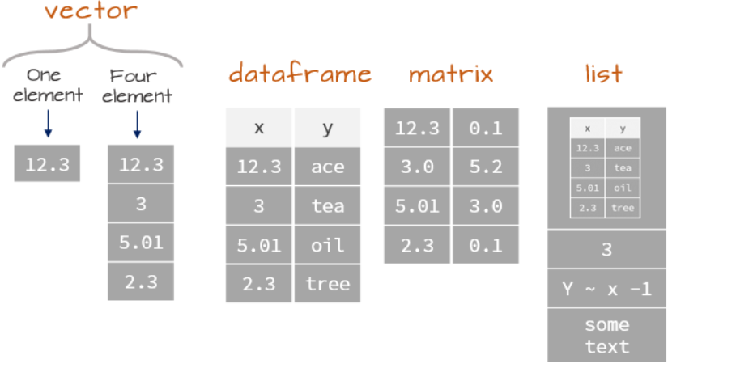
Object types: Data structure in R
Other....

Slide 21
Functions
function (object, arguments)
Performs actions of objects
You can always type ?function() is your console to get information about what the function does and which aeguments it accepts
Try typing in your console:
?str()

Slide 22
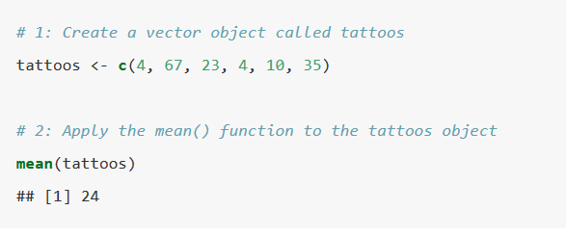
Objects and functions
Repeat with me: R is all about 2 things:
Objects and Functions
Lets define an object called tattoos using the function c() and then compute it mean using the function mean()

Slide 23

Challenge
Create a vector object called k consisting of the numbers 12, 13 and 14.
Compute the sum of the vector k using the function sum()

Slide 24

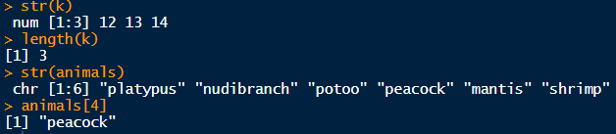
Inspecting objects
Lets create another vector called animals on top of the vector k we created earlier
Let´s inspect the vector k and the new vector animal.
What do you see? What are we doing with this?
Remember str() you will use it a lot!

Slide 25


Modifying vectors
Lets modify those vectors. Try this code chunks and think about what R is doing
Remember the [] can be used to refer to elements of an object. The referal can be a coordinate (e.g. first element k[1], or logical operations k[k<4]).
Can you figure out what´s going on below?

Slide 26

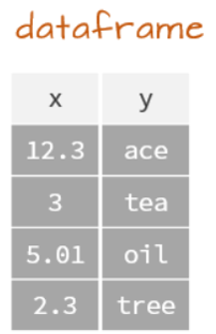

Data frames
Let´s create a more compex object: a data frame
Inspect it
Modify it

Slide 27
Data frames
Selecting data within a data frame is similar as we saw with vectors. We use [] as well, but now we have 2 coordinates.
dataframe[row, column] to select rows and columns of a dataframe
(omission of any of the coordinates means select all)

Slide 28

Data frames
Create the following dataset (called „data“) typing this code:
Visualize to understand what we just created

Slide 29
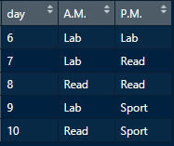
Challenge
What do these commands do?

Slide 30
R is all about what?
Objects and Functions

Slide 31
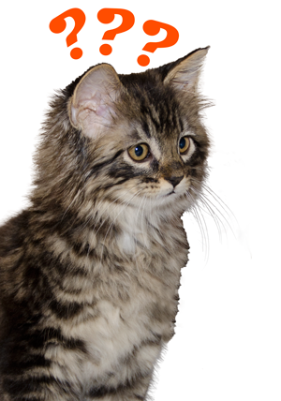
Questions?

Slide 32
Tutorial 2: Data collecting & quality check
Importing your data into R
Ramsy Agha
Feb 2020
Disease Eco-Evo Lab

Slide 33
Data handling: collecting and organizing
Conventions about data format
Observations are entered in rows
Variables are entered in columns
A column of data should contain only one data type

Slide 34
Data handling: collection and organization
Best practice
Store a copy of data in non-proprietary formats
Leave an uncorrected file when doing analyses
Create folders for relevant task to keep the overview over your analyses

Slide 35
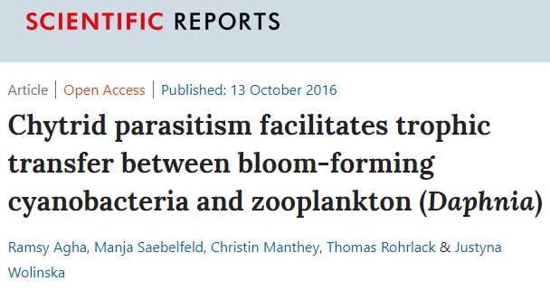
Data handling: Tutorial
Open tutorial file:
./Tutorials/ 1_Intro_to_Data_Manipulation_EXERCISE.html
Dataset from Agha et al. 2016
https://www.nature.com/articles/srep35039
Daphnia fed with 4 different diets (i.e. treatments)
4 files (treatment1.csv, treatment2.csv, treatment3.txt, treatment4.csv)
Objective: Import them in R, quality-inspect them and merge them into a master file

Slide 36
Data handling: Tutorial
Open tutorial file:
./Tutorials/ 1_Intro_to_Data_Manipulation_EXERCISE.html
Rules for this tutorial: Guided tutorial: Hints and solutions allowed - Run all the code on your laptop
NO COPY PASTING ALLOWED

Slide 37
Tutorial 3: Data manipulation – the apply funtions
Ramsy Agha
Feb 2020
Disease Eco-Evo Lab

Slide 38
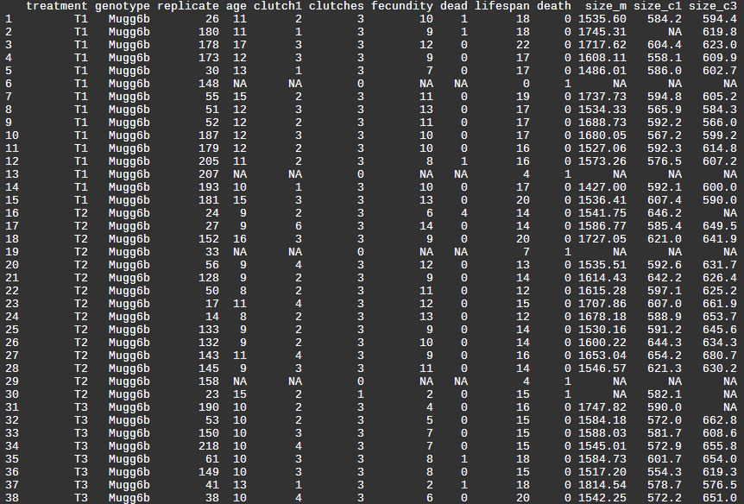
Apply functions
Sometimes you need to summarize your data:
Summary statistics:
Mean
Median
Standard deviation
n
Stardard Error etc
By groups (e.g. treatment)

Slide 39
Apply functions
R is a very powerful tool to do this kind of computations
Using a family of functions → The apply family (plyr package)
Allows you to perform several operations, incl.
Summarise
Mutate (i.e. transform, etc)
….
See documentation and get familiar with them (they are very useful!)

Slide 40
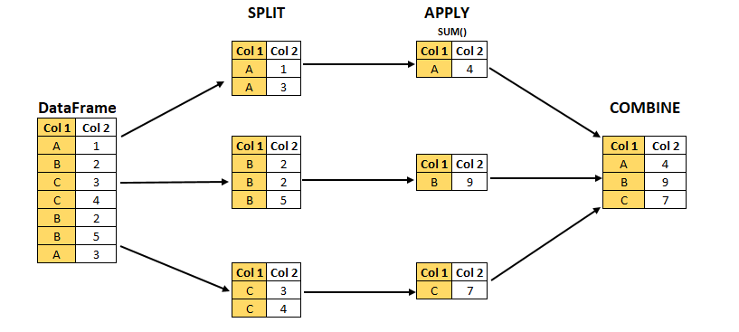
“Split - Apply- Combine” strategy

Slide 41
ddply(DataFrame, “Col_1”, summarise, sum(Col_2))

Slide 42
Apply functions: Tutorial
Open tutorial file:
./Tutorials/ 4_Apply_functions.html
Dataset from Agha et al. 2016 https://www.nature.com/articles/srep35039
Daphnia fed with 4 different diets (i.e. treatments)
Rules for this tutorial: Guided tutorial: Hints allowed (solutions only as last resort!)
- Run all the code on your laptop
NO COPY PASTING ALLOWED

Slide 43
Tutorial 4: Data visualization using ggplot2
Ramsy Agha
Feb 2020
Disease Eco-Evo Lab

Slide 44
Intro to ggplot2
R has several graphic packages
Base R graphics
Lattice
ggplot2
The most powerful of them is ggplot2 - Why?
Uses an intuitive grammar
Hierarchical
Additive
Coding efficient
Very versatile
Beautiful results

Slide 45
Apply functions: Tutorial
Open tutorial file:
./Tutorials/ 3_Intro_to_ggplot2_EXERCISE.html
Dataset from Agha et al. 2016 https://www.nature.com/articles/srep35039
Rules for this tutorial: Read the text, reveal code fi needed, type code in your RStudio, understand what is happening. Make questions if you don’t!
NO COPY PASTING ALLOWED

